Slide 1

Student Grades Data Analysis and Prediction
INFO6105 Data Science Methods and Tools
Jie Nan, Li Xiong, JiaLiu Cui

Slide 2
Outline
Introduction
Data Analysis
Model Building and Evaluation
Conclusion

Slide 3
Introduction

Slide 4
Data Set
Source: kaggle
https://www.kaggle.com/code/ahmedali058/student-grade-prediction-datascience-project/data
This data approach student achievement in secondary education of two Portuguese schools. The data attributes include student grades, demographic, social and school related features) and it was collected by using school reports and questionnaires. Important note: the target attribute G3 has a strong correlation with attributes G2 and G1. This occurs because G3 is the final year grade (issued at the 3rd period), while G1 and G2 correspond to the 1st and 2nd period grades. It is more difficult to predict G3 without G2 and G1, but such prediction is much more useful (see paper source for more details).

Slide 5
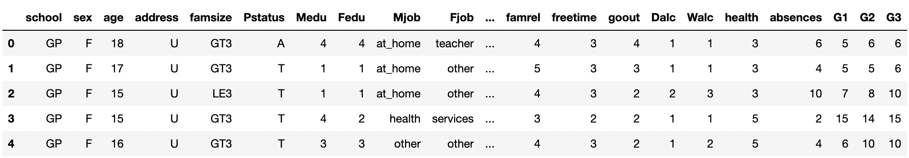
Data introduction
data.head(): Provide information on the first 5 rows of the dataset
About Data:
We have 395 entries and 33 columns

Slide 6
Data analysis
Find the related to difference features

Slide 7
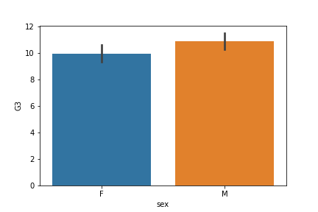
The relationship between gender and G3
Male perform better than female

Slide 8
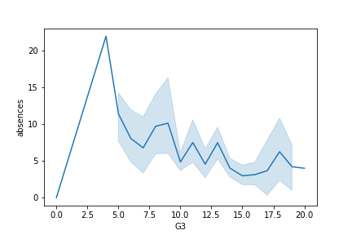
The relationship between absence and G3
The general trend is the more absences, the lower the grades. All absences are negatively correlated with grades

Slide 9
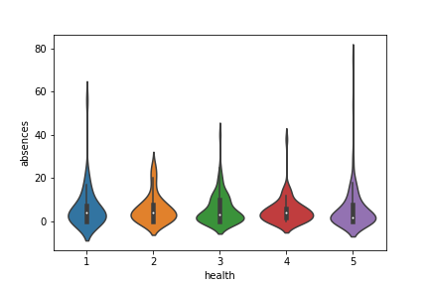
The relationship between absence and health
students who are absent for most of the classes is not for bad health

Slide 10
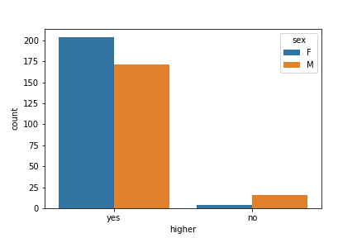
The relationship between different sex students' demand for higher education
Majority of students want higher education, girls are more willing than boys.

Slide 11
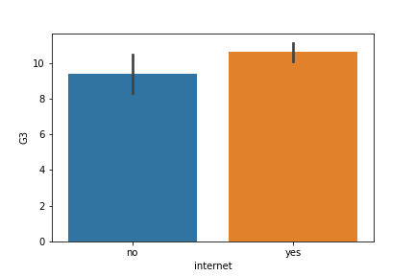
The relationship between Internet and G3
Students who got Internet connection has better score than students don't get Internet at home

Slide 12
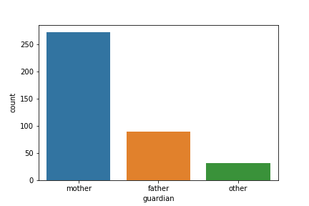
Student Guardian Statistics
Usually, the average family has the mother as the kid's guardian

Slide 13
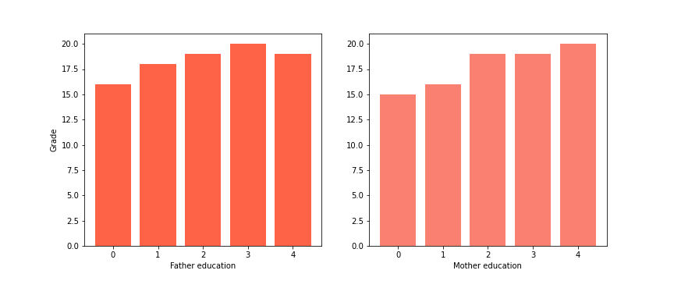
The relationship between parent's education level and Grade
Father's education level has less influence on children's grades than mother.

Slide 14
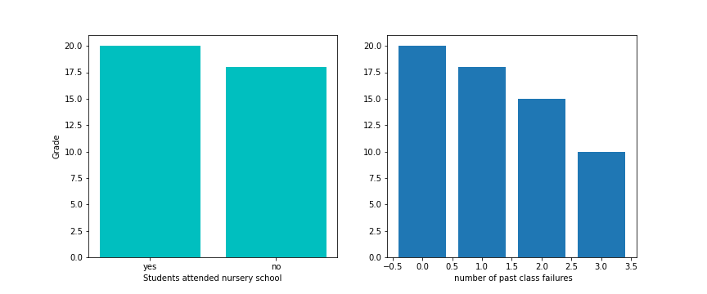
The relationship between nursery, class failure and G3.
Students in nursery school outperform those who haven't went to nursery.
And past grades are related to current grades. If students have more failures in previous courses, their current grades will be lower.

Slide 15
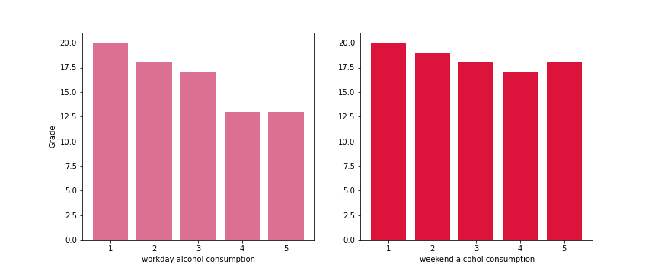
The relation between alcohol and G3
Alcohol in two parts, workday alcohol, high frequency student's grade lower than few frequency student. And weekend alcohol almost not affect grades.

Slide 16
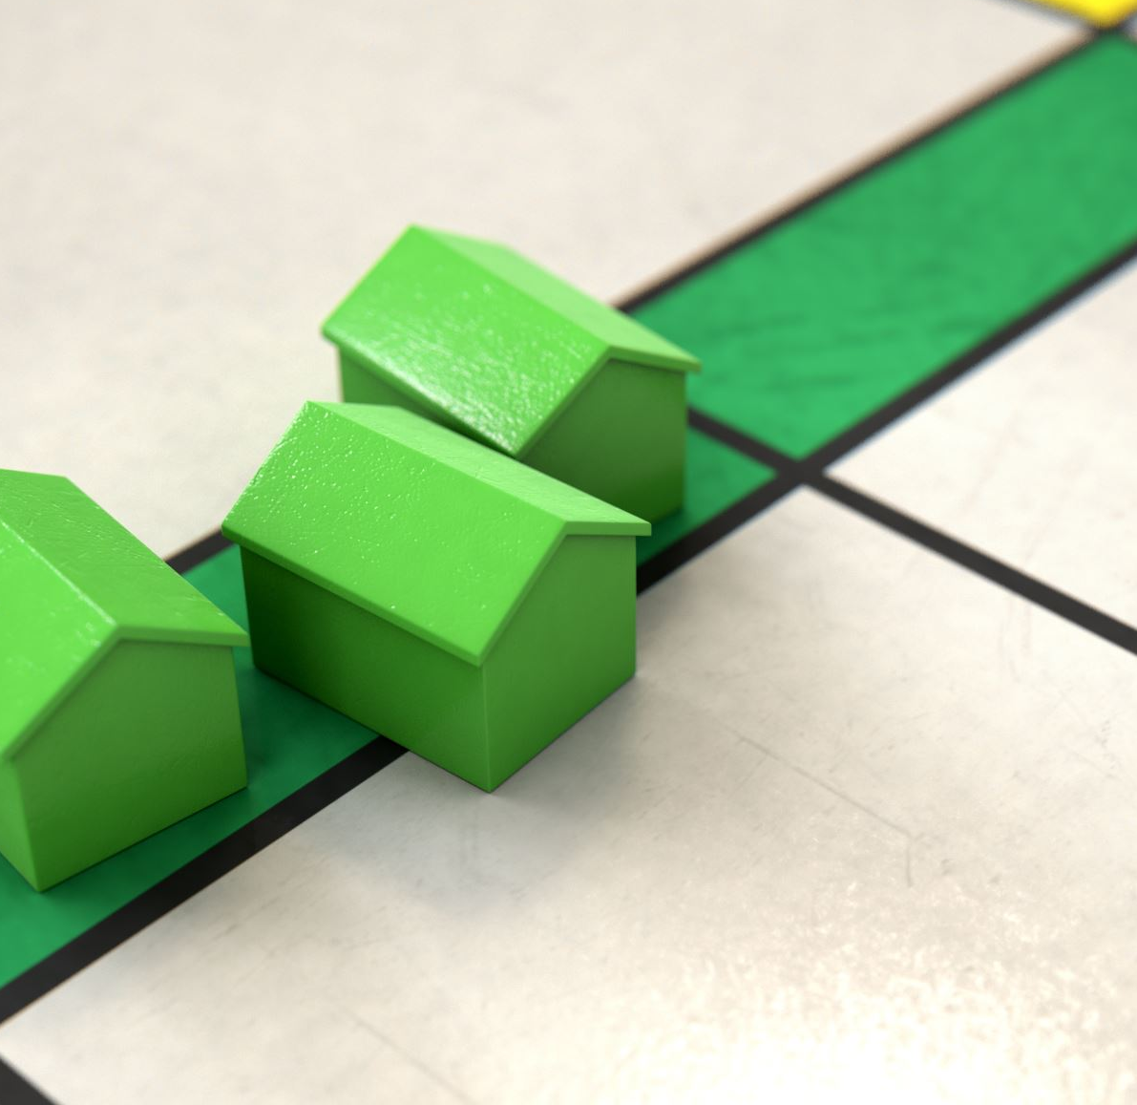
Model Building & Evaluation

Slide 17
Data Preprocessing Spilt Data (Train/Test Set:80/20)
Linear Regression
Decision Tree
Random Forest

Slide 18
Linear Regression
Data Processing:
First use pair-plot to check correlation between fields
Plot heat map to find out the most fields that are most correlated to G3
Select necessary features for the model
Fit the mode and check prediction accuracy

Slide 19
Correlation Analysis – Pair Plot

Slide 20
Correlation Analysis – Heat Map

Slide 21
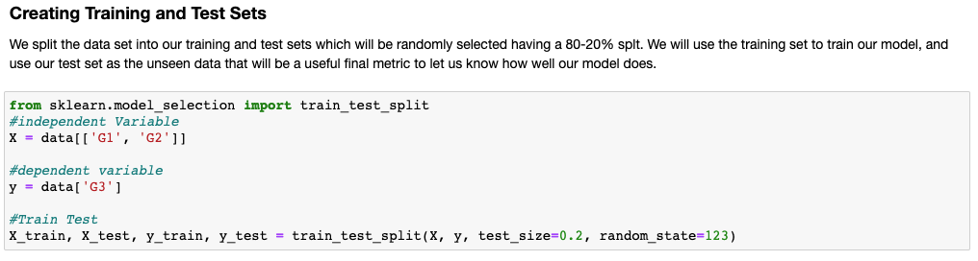
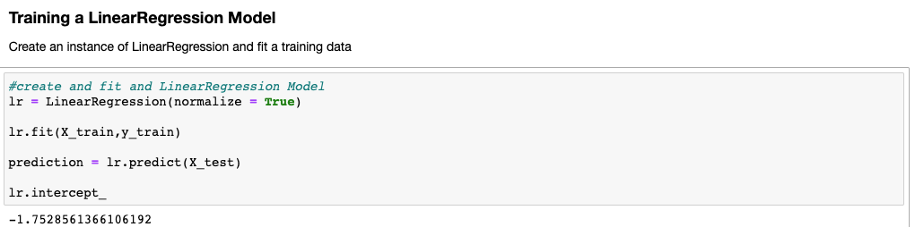
Creating data sets and fit model

Slide 22
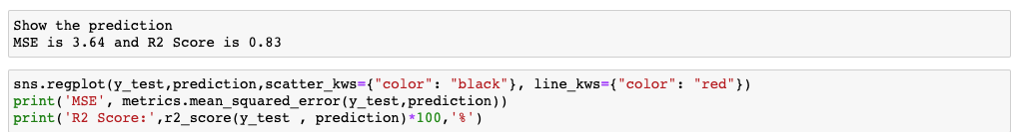
Show prediction accuracy

Slide 23
Decision Tree
Data Processing:
First Calculate the average grades based on three grades.
For catagorical values, we need to first turn them to number values, so that we can evaluate the attributes.
Then in order to predict the grades, we need to remove the grade attributes.
Last, for predicting, we can first set an X to store the attributes of the students, and Y to store the grade

Slide 24
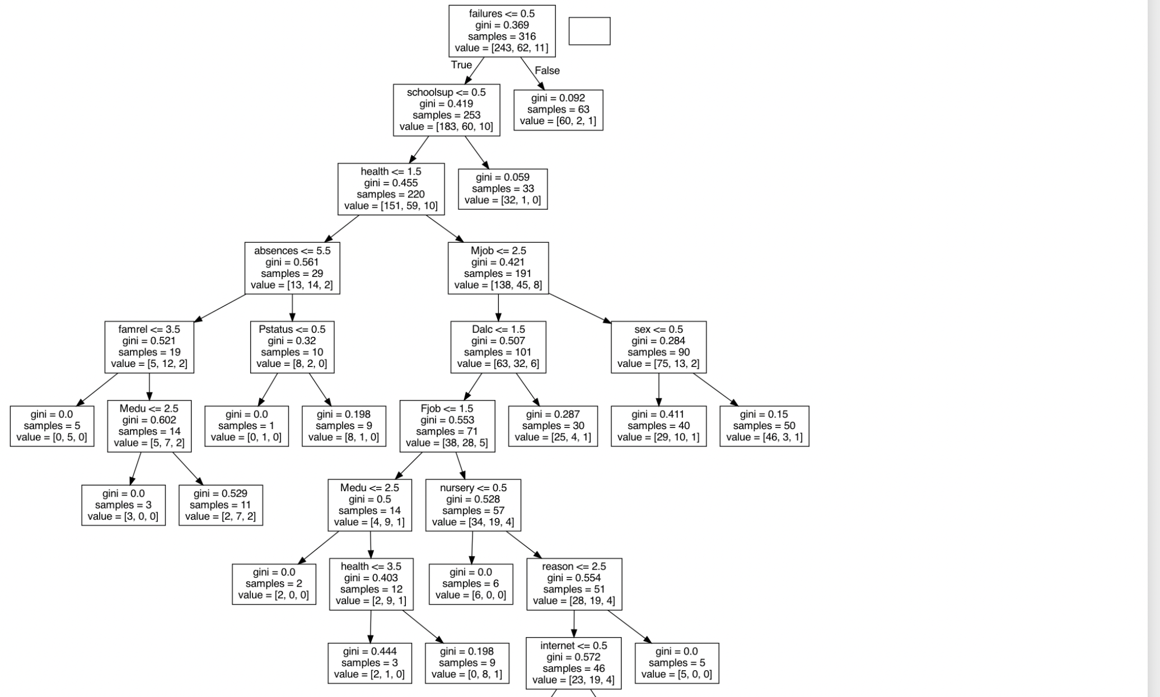

Slide 25
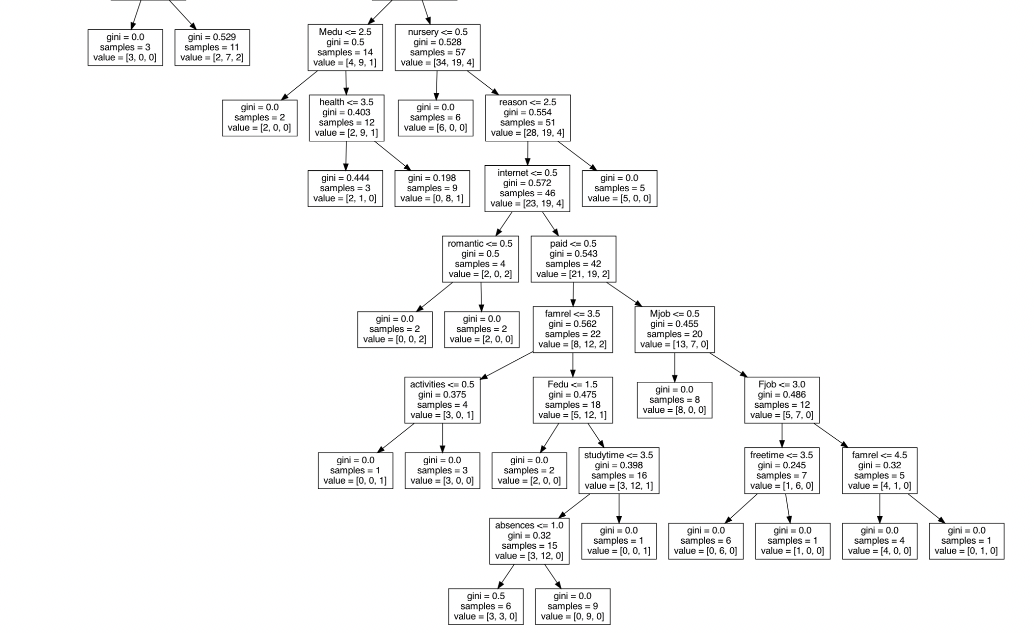

Slide 26
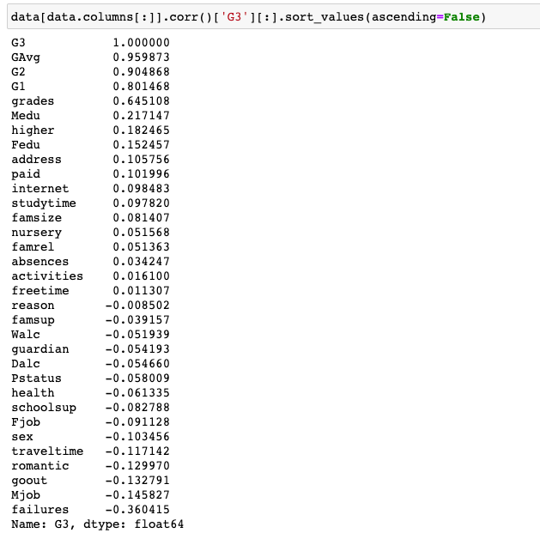
Random Forest

Slide 27
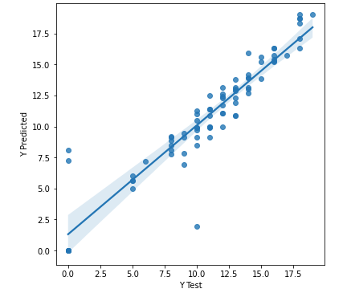
Random Forest
Data Processing:
I choose G2,G1 and absences as my independent variable, and G3 as my dependent variable
Create an instance of Random Forest Regressor class and fit it to a training data
Create prediction from test set and get accuracy of the classifier
Get plot the predicted values of the test data.

Slide 28
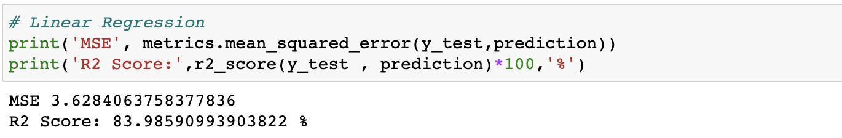
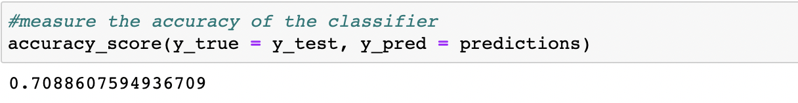
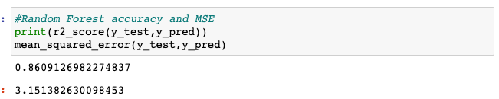
Model Evaluation

Slide 29
Linear Regression Model accuracy is more than 83.9%
Decision Tree Model accuracy is 77.5%
Random Forest Model accuracy is 86%
The best model is Random Forest Model,and the performance of Linear Regression Model is slightly better than that of Decision Tree model .

Slide 30

Conclusion

Slide 31
Conclusion
Explored the dataset from a school
Build three models:Linear Regression,Decision Tree and Random Forest
Random Forest model proform slighty is the best
This school can use Random Forest model to predict student's grades.

Slide 32
THANK YOU

